Slide 1


By Sandesh Yadav
4th December 2021

Slide 2

Outline
Executive Summary
Introduction
Methodology
Results
Conclusion
Appendix

Slide 3

Executive Summary
Summary of methodologies
Data Collection
Data Wrangling
EDA with data visualization
EDA with SQL
Building an interactive map with Folium
Building a Dashboard with Plotly Dash
Predictive analysis
Summary of all results
Exploratory Data Analysis results
Interactive analytics demo in screenshots
Predictive analysis results

Slide 4

Introduction
Project background and context
We predicted if the Falcon 9 first stage will land successfully. SpaceX advertises Falcon 9 rocket launches on its website, with a cost of 62 million dollars; other providers cost upward of 165 million dollars each, much of the savings is because SpaceX can reuse the first stage. Therefore, if we can determine if the first stage will land, we can determine the cost of a launch. This information can be used if an alternate company wants to bid against SpaceX for a rocket launch.
Problems you want to find answers
What influences if the rocket will land successfully?
The effect each relationship with certain rocket variables will impact in determining the success rate of a successful landing.
What conditions does SpaceX have to achieve to get the best results and ensure the best rocket success landing rate.

Slide 5


Slide 6
Methodology
Executive Summary
Data collection methodology:
SpaceX Rest API
(Web Scrapping) from Wikipedia
Perform data wrangling (Transforming data for Machine Learning)
One hot encoding data fields for Machine Learning and dropping irrelevant columns
Perform exploratory data analysis (EDA) using visualization and SQL
Plotting Scatter graphs, Bar graphs to show relationships between variables to detect any pattern
Perform interactive visual analytics using Folium and Plotly Dash
Perform predictive analysis using classification models
How to build, tune, evaluate classification models

Slide 7
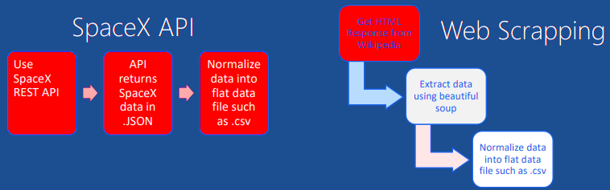
Data Collection
They following datasets were collected by
We worked with SpaceX launch data that is gathered from the SpaceX REST API.
This API will give us data about launches, including information about the rocket used, payload delivered, launch specifications, landing specifications, and landing outcome.
Our goal is to use this data to predict whether SpaceX will attempt to land a rocket or not.
The SpaceX REST API endpoints, or URL, starts with api.spacexdata.com/v4/.
Another popular data source for obtaining Falcon 9 Launch data is web scraping Wikipedia using BeautifulSoup.

Slide 8
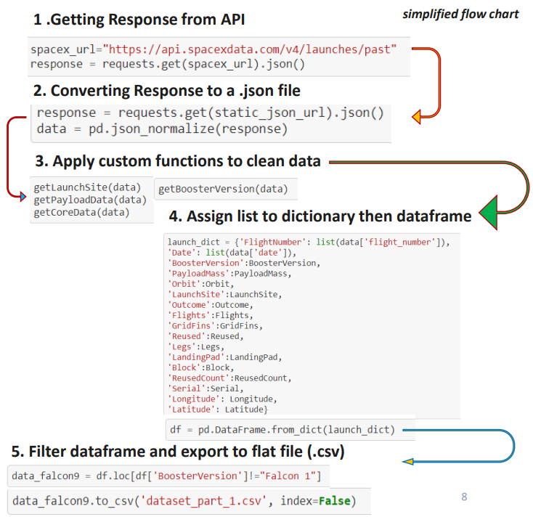
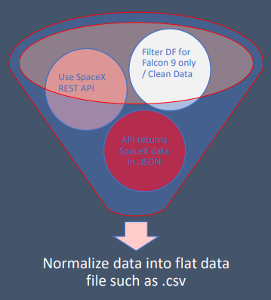
Data Collection – SpaceX API
GitHub URL to Notebook

Slide 9
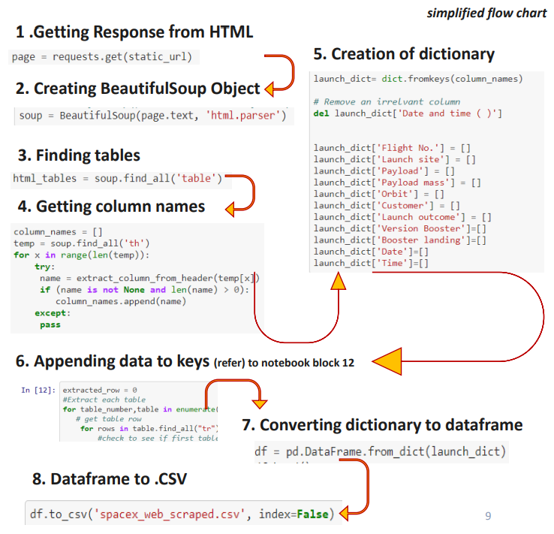
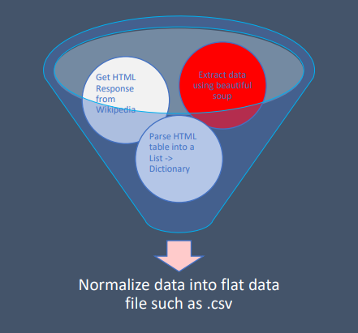
Data Collection - Scrapping
GitHub URL to Notebook

Slide 10

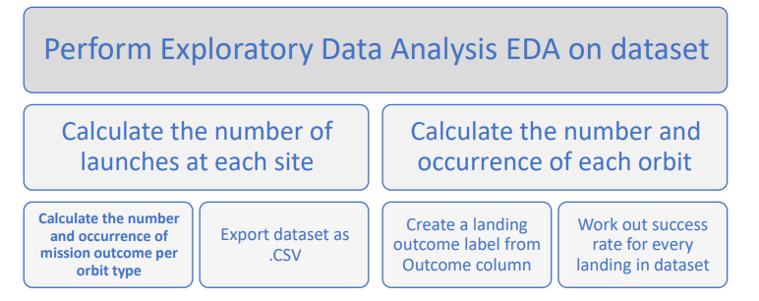
Data Wrangling
Introduction
In the data set, there are several different cases where the booster did not land successfully. Sometimes a landing was attempted but failed due to an accident; for example, True Ocean means the mission outcome was successfully landed to a specific region of the ocean while False Ocean means the mission outcome was unsuccessfully landed to a specific region of the ocean. True RTLS means the mission outcome was successfully landed to a ground pad False RTLS means the mission outcome was unsuccessfully landed to a ground pad. True ASDS means the mission outcome was successfully landed on a drone ship False ASDS means the mission outcome was unsuccessfully landed on a drone ship. We mainly convert those outcomes into Training Labels with 1 means the booster successfully landed 0 means it was unsuccessful
Process
GitHub URL to Notebook

Slide 11



EDA with Data Visualization
GitHub URL to Notebook
Scatter Graphs being drawn:
Flight Number VS. Payload Mass
Flight Number VS. Launch Site
Payload VS. Launch Site
Orbit VS. Flight Number
Payload VS. Orbit Type
Orbit VS. Payload Mass
Scatter plots show how much one variable is affected by another. The relationship between two variables is called their correlation . Scatter plots usually consist of a large body of data.
Bar Graph being drawn:
Mean VS. Orbit
A bar diagram makes it easy to compare sets of data between different groups at a glance. The graph represents categories on one axis and a discrete value in the other. The goal is to show the relationship between the two axes. Bar charts can also show big changes in data over time.
Line Graph being drawn:
Success Rate VS. Year
Line graphs are useful in that they show data variables and trends very clearly and can help to make predictions about the results of data not yet recorded

Slide 12

EDA with SQL
Performed SQL queries to gather information about the dataset.
For example of some questions we were asked about the data we needed information about. Which we are using SQL queries to get the answers in the dataset :
• Displaying the names of the unique launch sites in the space mission
• Displaying 5 records where launch sites begin with the string 'KSC’
• Displaying the total payload mass carried by boosters launched by NASA (CRS)
• Displaying average payload mass carried by booster version F9 v1.1
• Listing the date where the successful landing outcome in drone ship was achieved.
• Listing the names of the boosters which have success in ground pad and have payload mass greater than 4000 but less than 6000
• Listing the total number of successful and failure mission outcomes
• Listing the names of the booster_versions which have carried the maximum payload mass.
• Listing the records which will display the month names, successful landing_outcomes in ground pad ,booster versions, launch_site for the months in year 2017
• Ranking the count of successful landing_outcomes between the date 2010-06-04 and 2017-03-20 in descending order
GitHub URL to Notebook

Slide 13
Build an Interactive Map with Folium
To visualize the Launch Data into an interactive map. We took the Latitude and Longitude Coordinates at each launch site and added a Circle Marker around each launch site with a label of the name of the launch site.
We assigned the dataframe, launch_outcomes(failures, successes) to classes 0 and 1 with Green and Red markers on the map in a MarkerCluster()
Using Haversine’s formula we calculated the distance from the Launch Site to various landmarks to find various trends about what is around the Launch Site to measure patterns. Lines are drawn on the map to measure distance to landmarks
Example of some trends in which the Launch Site is situated in.
Are launch sites in close proximity to railways? No
Are launch sites in close proximity to highways? No
Are launch sites in close proximity to coastline? Yes
Do launch sites keep certain distance away from cities? Yes

Slide 14
Build a Dashboard with Plotly Dash
Used Python Anywhere to host the website live 24/7 so your can play around with the data and view the data
The dashboard is built with Plotly Dash web framework.
Graphs:
Pie Chart showing the total launches by a certain site/all sites
Display relative proportions of multiple classes of data.
Size of the circle can be made proportional to the total quantity it represents.
Scatter Graph showing the relationship with Outcome and Payload Mass (Kg) for the different Booster Versions
It shows the relationship between two variables.
It is the best method to show you a non-linear pattern.
The range of data flow, i.e. maximum and minimum value, can be determined.
Observation and reading are straightforward.
GitHub URL to Notebook

Slide 15

GitHub URL to Notebook
Predictive Analysis (Classification)
Building Model:
Load our dataset into NumPy and Pandas
Transform Data
Split our data into training and test data sets
Check how many test samples we have
Decide which type of machine learning algorithms we want to use
Set our parameters and algorithms to GridSearchCV
Fit our datasets into the GridSearchCV objects and train our dataset.
Evaluating Model:
Check accuracy for each model
Get tuned hyperparameters for each type of algorithms
Plot Confusion Matrix
Improving the Model:
Feature Engineering
Algorithm Tuning
The model with the best accuracy score will be chosen as the performing model.

Slide 16

Results
Exploratory data analysis results
Interactive analytics demo in screenshots
Predictive analysis results

Slide 17


Slide 18
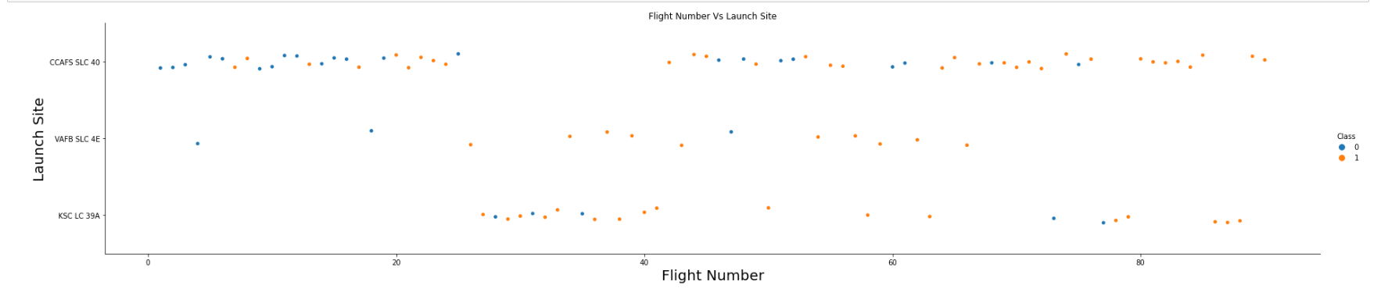
Flight Number vs. Launch Site
The more amount of flights at a launch site the greater the success rate at a launch site.

Slide 19
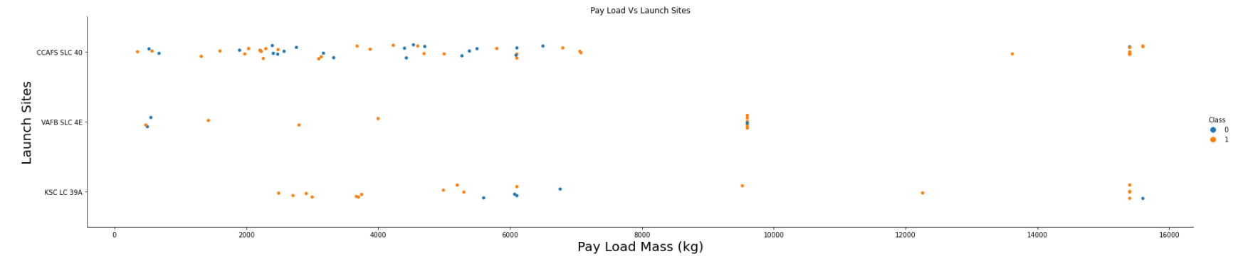
Payload vs. Launch Site
For the VAFB-SLC launch site there are no rockets launched for heavy payload mass(greater than 10000).

Slide 20
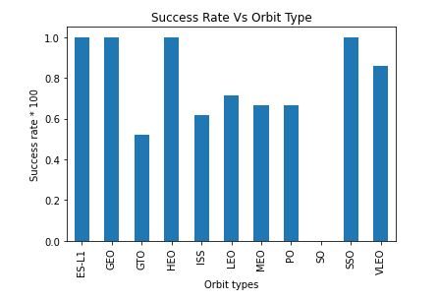
Success Rate vs. Orbit Type
Orbits ES-L1, GEO, HEO, and SSO have the highest Success Rate

Slide 21
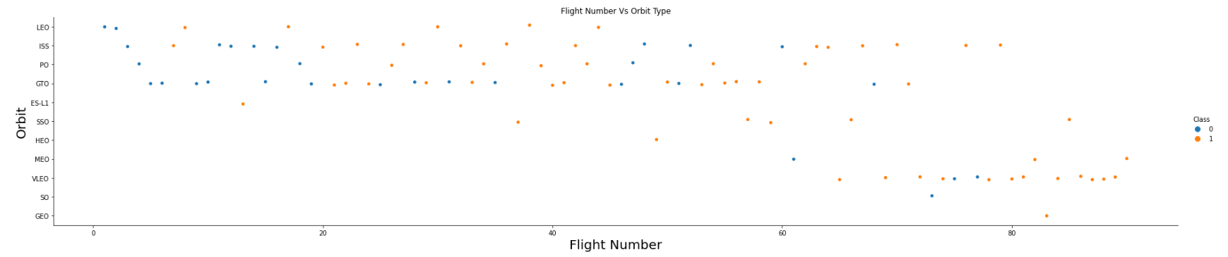
Flight Number vs. Orbit Type
In the LEO orbit the Success appears related to the number of flights; on the other hand, there seems to be no relationship between flight number when in GTO orbit.

Slide 22
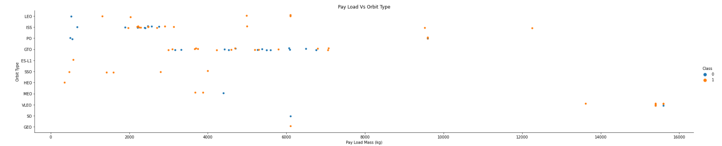
Payload vs. Orbit Type
With heavy payloads the successful landing or positive landing rate are more for PO, LEO and ISS.
However for GTO we cannot distinguish this well as both positive landing rate and negative landing(unsuccessful mission) are both there here.

Slide 23
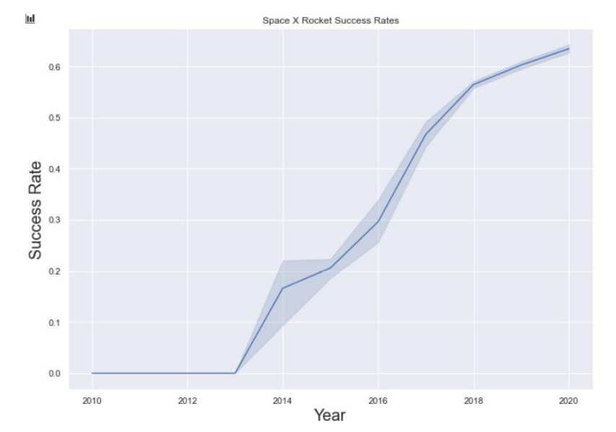
Launch Success Yearly Trend
You can observe that the success rate since 2013 kept increasing till 2020

Slide 24

Section 3
EDA with SQL

Slide 25
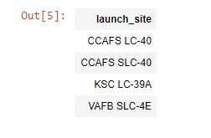

All Launch Site Names
SQL QUERY:
SELECT DISTINCT(Launch_Site)
FROM SPACEXTBL
QUERY EXPLAINATION:
Using the word DISTINCT in the query means that it will only show Unique values in the Launch_Site column from tblSpaceX

Slide 26
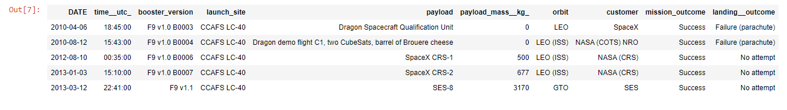
Launch Site Names Begin with 'CCA'
SQL QUERY:
SELECT *
FROM SPACEXTBL
WHERE Launch_Site
LIKE “CCA%”
LIMIT 5
QUERY EXPLAINATION:
Using the word LIMIT 5 in the query means that it will only show 5 records from SPACEXTBL and LIKE keyword has a wild card with the words ‘CCA%’ the percentage in the end suggests that the Launch_Site name must start with CCA.

Slide 27
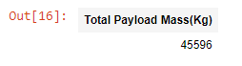
Total Payload Mass
QUERY EXPLAINATION
Using the function SUM summates the total in the column PAYLOAD_MASS_KG_
The WHERE clause filters the dataset to only perform calculations on Customer NASA (CRS)
SQL QUERY:
SELECT SUM(payload_mass__kg_)
AS “Total Payload Mass(Kg)”
FROM SPACEXTBL
WHERE customer = “NASA (CRS)”

Slide 28
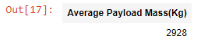
Average Payload Mass by F9 v1.1
SQL QUERY:
SELECT AVG(payload_mass__kg_)
AS "Average Payload Mass(Kg)"
FROM SPACEXTBL
WHERE booster_version = 'F9 v1.1'
QUERY EXPLAINATION:
Using the function AVG works out the average in the column PAYLOAD_MASS_KG_
The WHERE clause filters the dataset to only perform calculations on Booster_version F9 v1.1

Slide 29
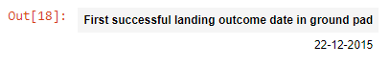
First Successful Ground Landing Date
SQL QUERY:
SELECT MIN(DATE)
AS "First successful landing outcome date in ground pad"
FROM SPACEXTBL
WHERE landing__outcome = 'Success (ground pad)'
QUERY EXPLANATION:
Using the function MIN works out for the minimum date in the column Date
The WHERE clause filters the dataset to only perform calculations on Landing_Outcome Success (Ground Pad)

Slide 30
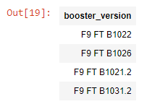
Successful Drone Ship Landing with Payload between 4000 and 6000
SQL QUERY:
SELECT booster_version
FROM SPACEXTBL
WHERE landing__outcome = 'Success (drone ship)’
AND payload_mass__kg_ BETWEEN 4000 AND 6000
QUERY EXPLANATION:
Selecting only Booster_Version
The WHERE clause filters the dataset to Landing_Outcome = Success (drone ship)
The AND clause specifies additional filter conditions Payload_MASS_KG_ > 4000 AND Payload_MASS_KG_ < 6000

Slide 31
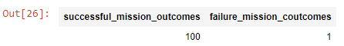
Total Number of Successful and Failure Mission Outcomes
SQL QUERY:
SELECT(SELECT Count(mission_outcome)
from SPACEXTBL
where mission_outcome LIKE '%Success%’)
as Successful_Mission_Outcomes,
(SELECT Count(mission_outcome)
from SPACEXTBL
where mission_outcome LIKE '%Failure%’)
as Failure_Mission_Coutcomes
FROM SPACEXTBL
LIMIT 1
QUERY EXPLANATION:
This query is a bit complicated and hard, we used subqueries here to produce the results. The LIKE ‘%Success%’ and LIKE ‘%Failure’ wildcards shows that in the record the given phrase is in any part of the string in the records.

Slide 32
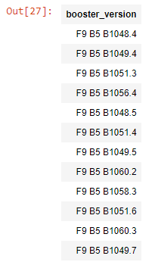
Boosters Carried Maximum Payload
SQL QUERY:
SELECT DISTINCT(booster_version)
FROM SPACEXTBL
WHERE payload_mass__kg_ =
(SELECT MAX(payload_mass__kg_)
FROM SPACEXTBL)
QUERY EXPLANATION:
Using the word DISTINCT in the query means that it will only show Unique values in the booster_version column from SPACEXTBL
Using the function MAX works out for the MAXIMUM payload in the column payload_mass__kg_

Slide 33
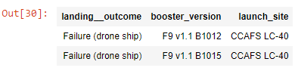
2015 Launch Records
SQL QUERY:
SELECT landing__outcome, booster_version, launch_site
FROM SPACEXTBL
WHERE YEAR(DATE) = 2015
AND landing__outcome LIKE '%Failure%'
QUERY EXPLANATION:
The YEAR() function returns only the year part of the date i.e. YYYY. WHERE clause filters Year to be 2015.

Slide 34


Slide 35
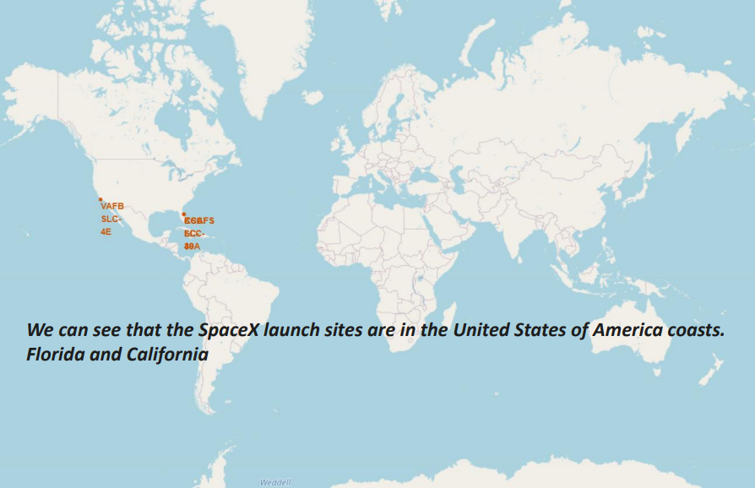
All SpaceX launch sites globally

Slide 36

Launch Sites with labelled markers

Slide 37
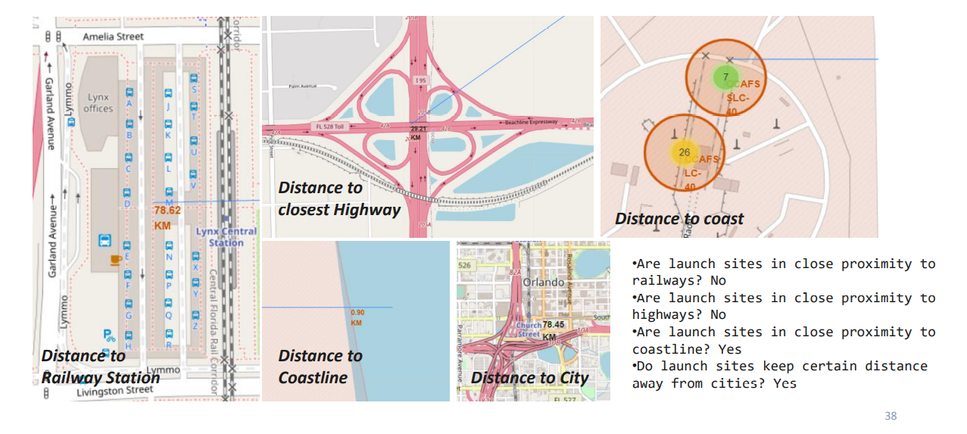
Launch Sites with their distances to their proximities

Slide 38


Slide 39
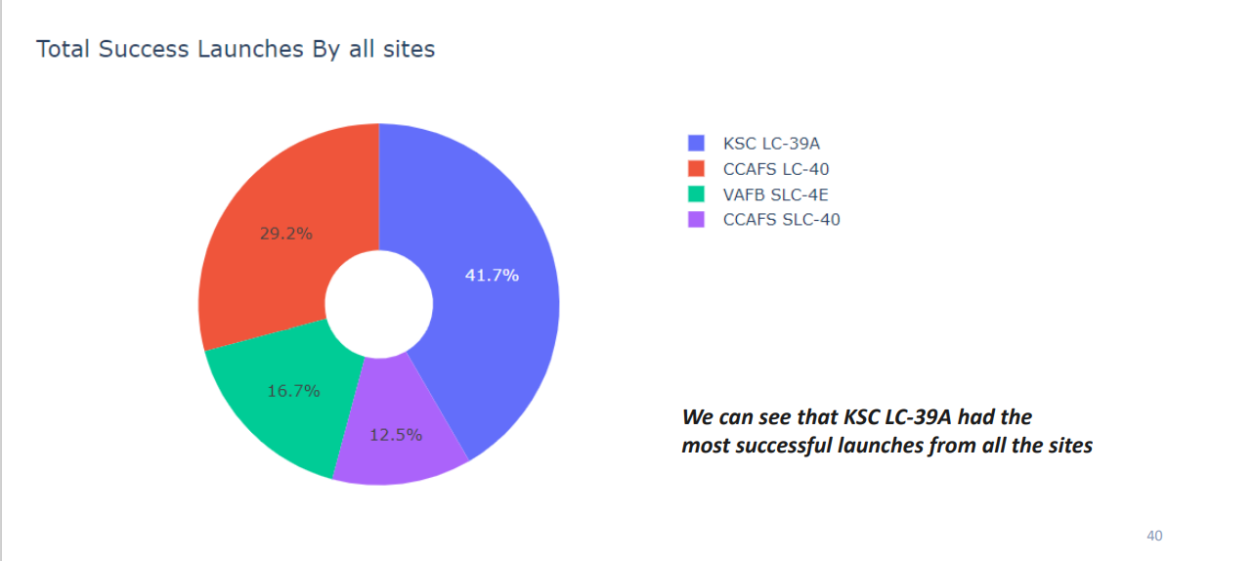


DASHBOARD – Pie chart showing the success percentage achieved by each launch site

Slide 40
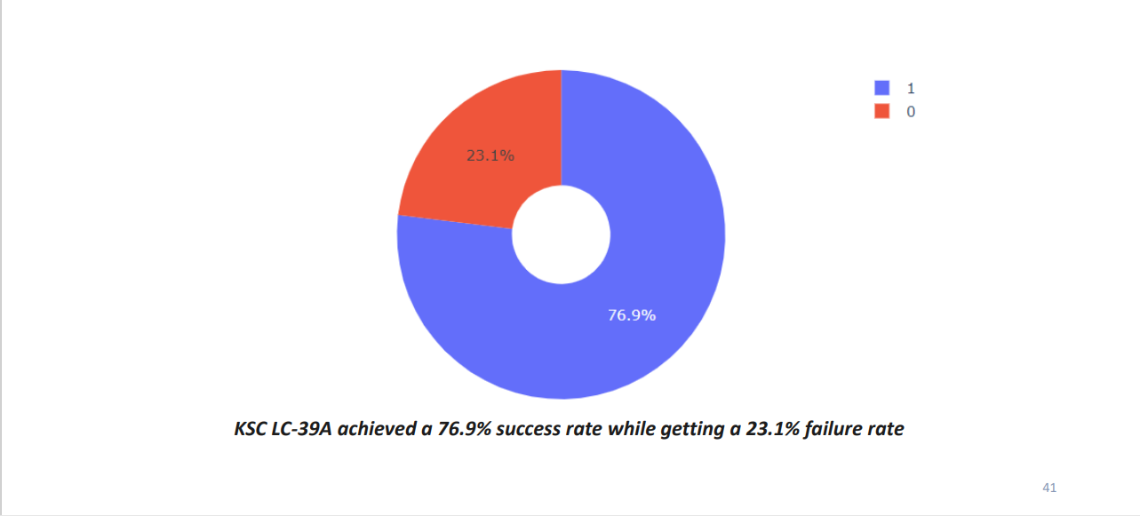
DASHBOARD – Pie chart for the launch site with highest launch success ratio

Slide 41
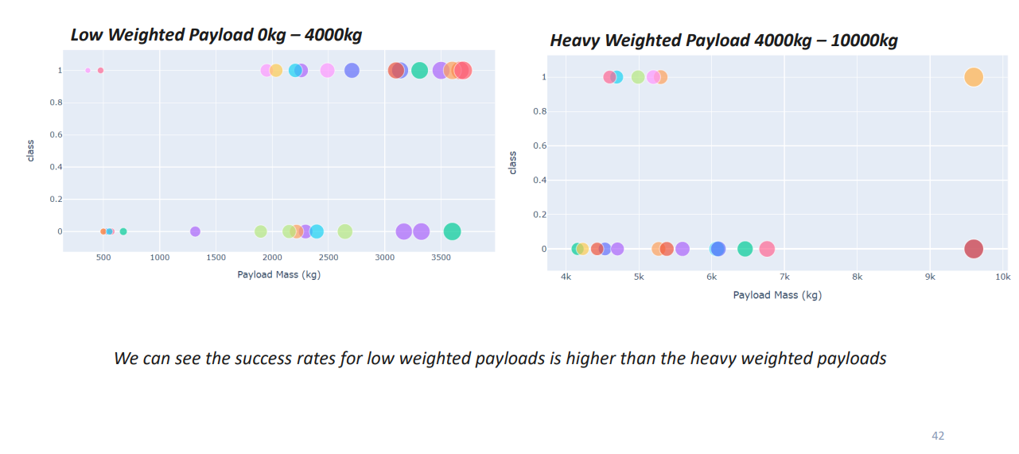

DASHBOARD – Payload vs. Launch Outcome scatter plot for all sites, with different payload selected in the range slider

Slide 42


Slide 43
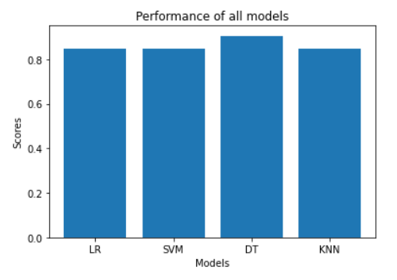
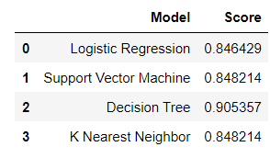
Classification Accuracy using test data
As you can see that the accuracies of all the models is quite close, but the Decision Tree model seems to perform well than others.

Slide 44
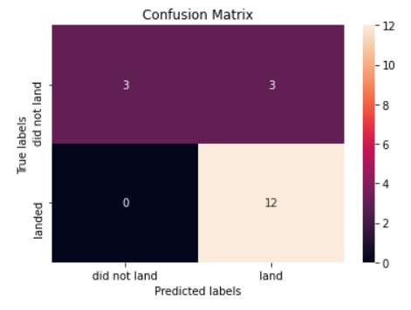
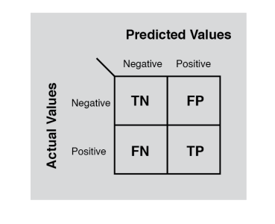
Confusion Matrix for the Decision Tree
Examining the confusion matrix for the Decision Tree, we observe that model can distinguish between the different classes quite well. We can also observe that there is a problem i.e. false positives.

Slide 45

Conclusions
The Tree Classifier Algorithm is the best for Machine Learning for this dataset
Low weighted payloads perform better than the heavier payloads
The success rates for SpaceX launches is directly proportional time in years they will eventually perfect the launches
We can see that KSC LC-39A had the most successful launches from all the sites
Orbit GEO,HEO,SSO,ES-L1 has the best Success Rate

Slide 46
Appendix
Haversine formula
ADGGoogleMaps Module (not used but created)
Module sqlserver (ADGSQLSERVER)
PythonAnywhere 24/7 dashboard

Slide 47


